Slide 1

Prediction of Bank Churn Customer
By: Selva Rama Bala Subramanian S​
Mentors:
Ms. Komilla Bhatia
Ms. Nisha Jenipher

Slide 2
AGENDA
Introduction​
Business Scenario
​Model Selection and Evaluation
Prediction of Churn Customers
​Summary​

Slide 3
Introduction
The Machine Learning Classification algorithm is a Supervised Learning technique that is used to identify the category of new observations on the basis of training data. In Classification, a program learns from the given dataset or observations and then classifies new observation into a number of classes or groups. Classes can be called as targets/labels or categories.

Slide 4
Business Objective
4
Build a predictive model to determine which
customers are likely to churn (leave the bank)
Given a set of customer record, determine the
probabilities of churn for each customer

Slide 5





Model selection AND EVALUATION
Choose the model
Fit the model
Predict the model
Accuracy of the model
Best model
Decision Tree Classifier
LGBM Classifier
Fit the model using x and y train
Predict the trained model using x test
Calculate the ROC AUC Score of the each model for the comparison
LGBM Classifier is the best model with good ROC AUC Score.

Slide 6
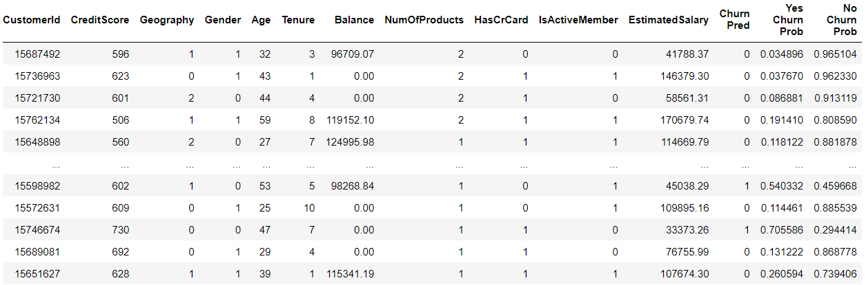
Predictions of Churn Customers:

Slide 7
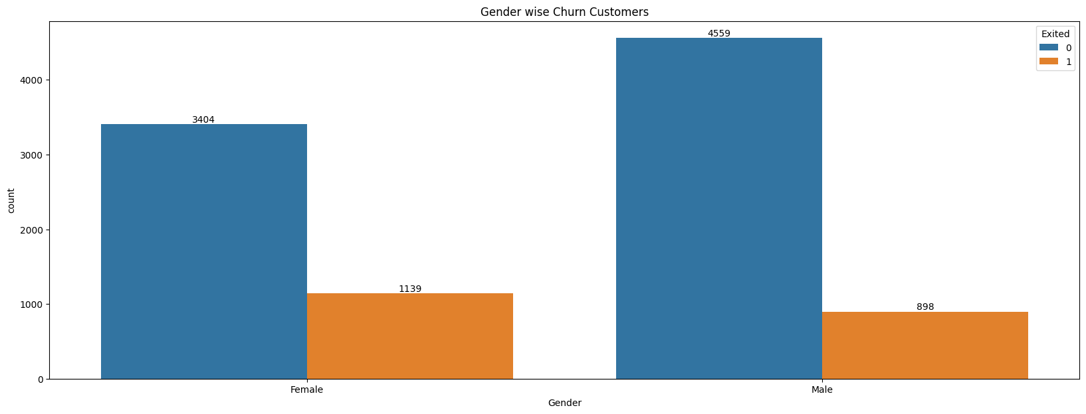
Gender wise churn Analysis

Slide 8
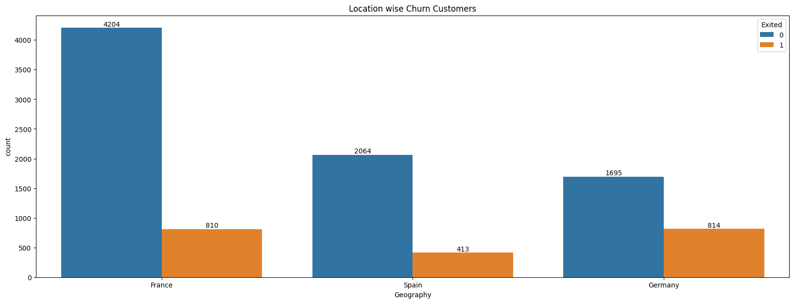
Location wise churn Analysis

Slide 9
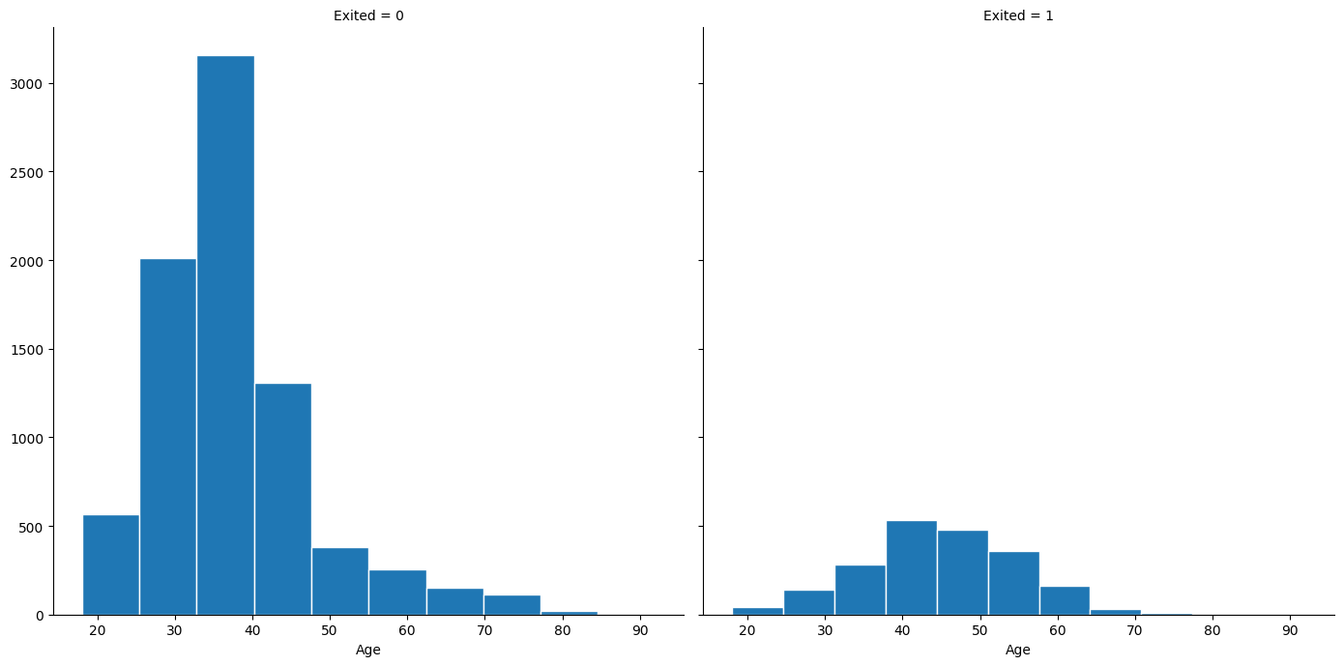
Age wise churn Analysis

Slide 10
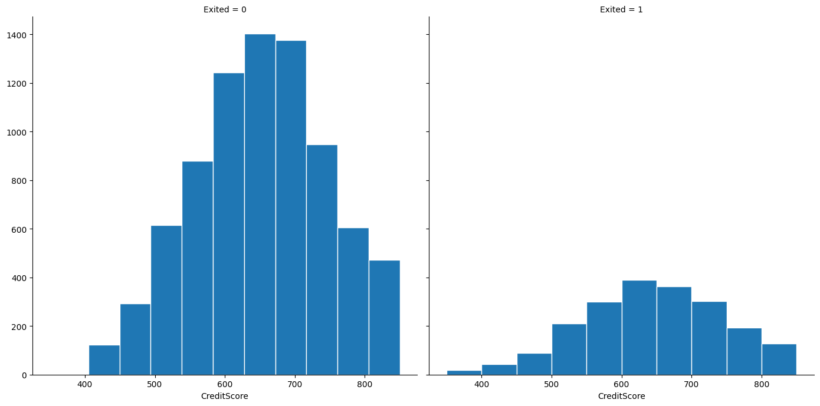
CREDIT SCORE WISE CHURN

Slide 11
SUMMARY
1) Important Features Deciding the Churn of Customers are:
Age
Balance
No of Products
Estimated Salary
- Credit Score
2) Probability of Top 10 Probability of customers who can stay with the Bank:
- 15812007, 15580988, 15640635, 15801488, 15651958, 15803716, 15598614, 15615330, 15624592, 15569120
3) Probability of Top 10 Probability of customers who can leave the Bank:
15589017, 15610383, 15599329, 15710087, 15568006, 15601594, 15603554, 15692750, 15668889, 15640846

Slide 12
Business Summary
Majority of the customers with good credit score are leaving the organization. To overcome that loss, The bank can provide Loan to those customers with better credit score and has zero default.

Slide 13
THANK YOU

